Slide 1

Music Generation with Neural Network Models
By: David Castillo

Slide 2
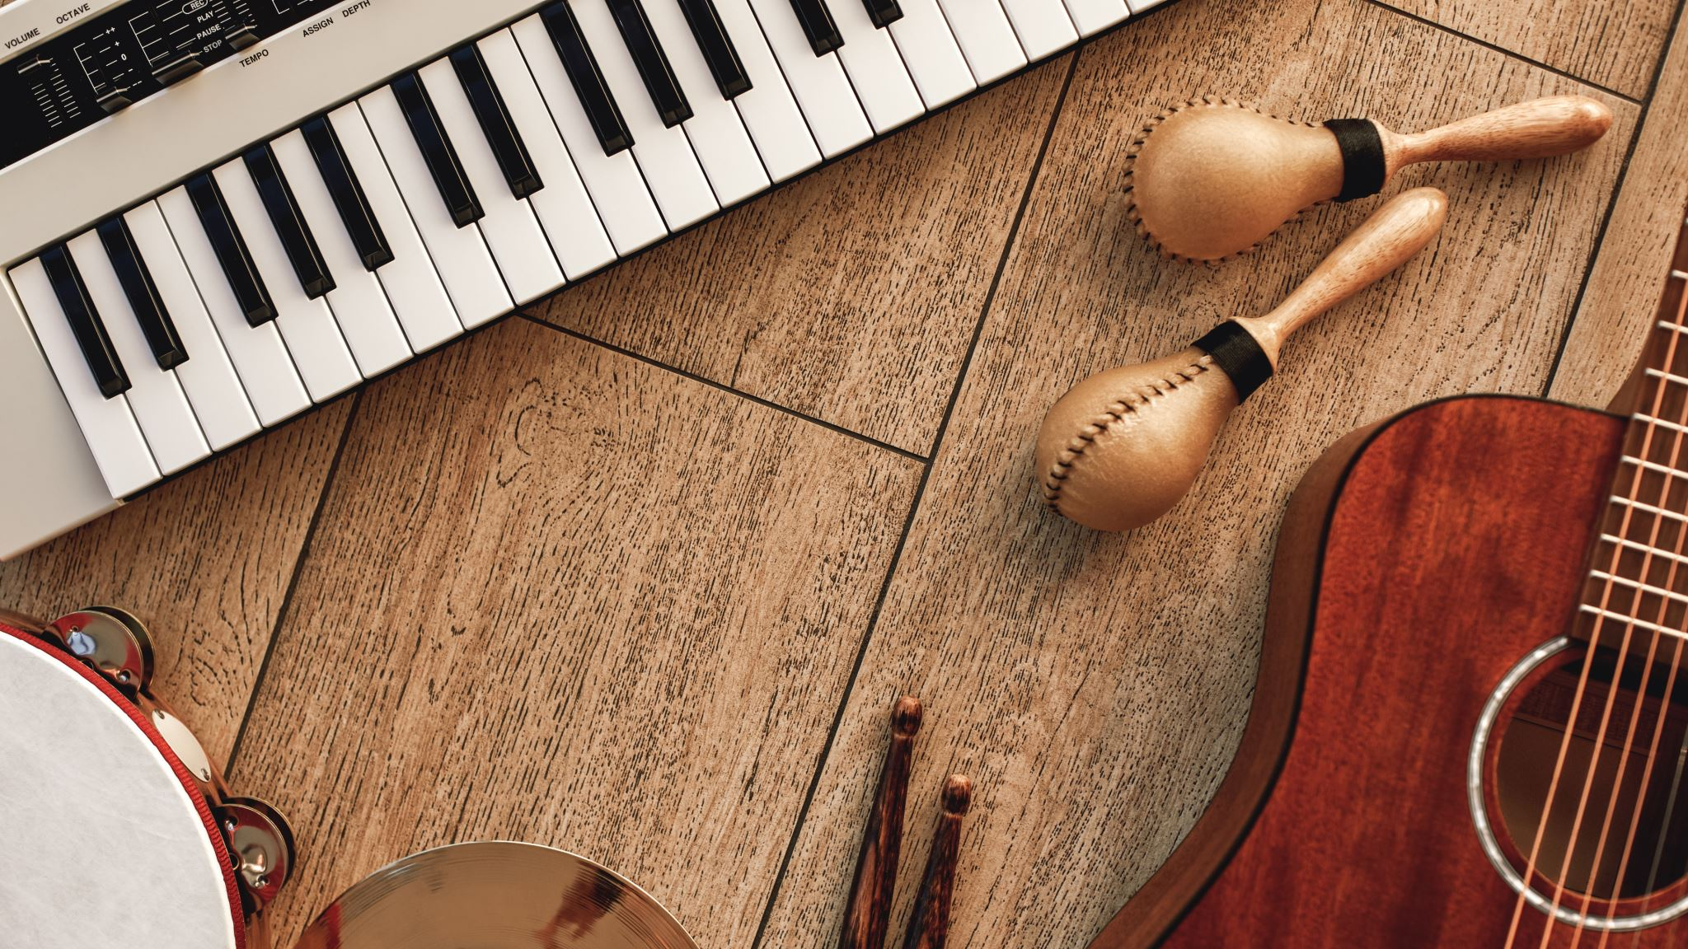
Problem Statement
Increasing expenses from clearing samples
Generate music through machine learning
Gauge success via minimizing the value loss function
Is music created dynamic or monotone?

Slide 3

Background Research

Slide 4

Music
The art of music
Debatable origins
Significant cultural pillar

Slide 5
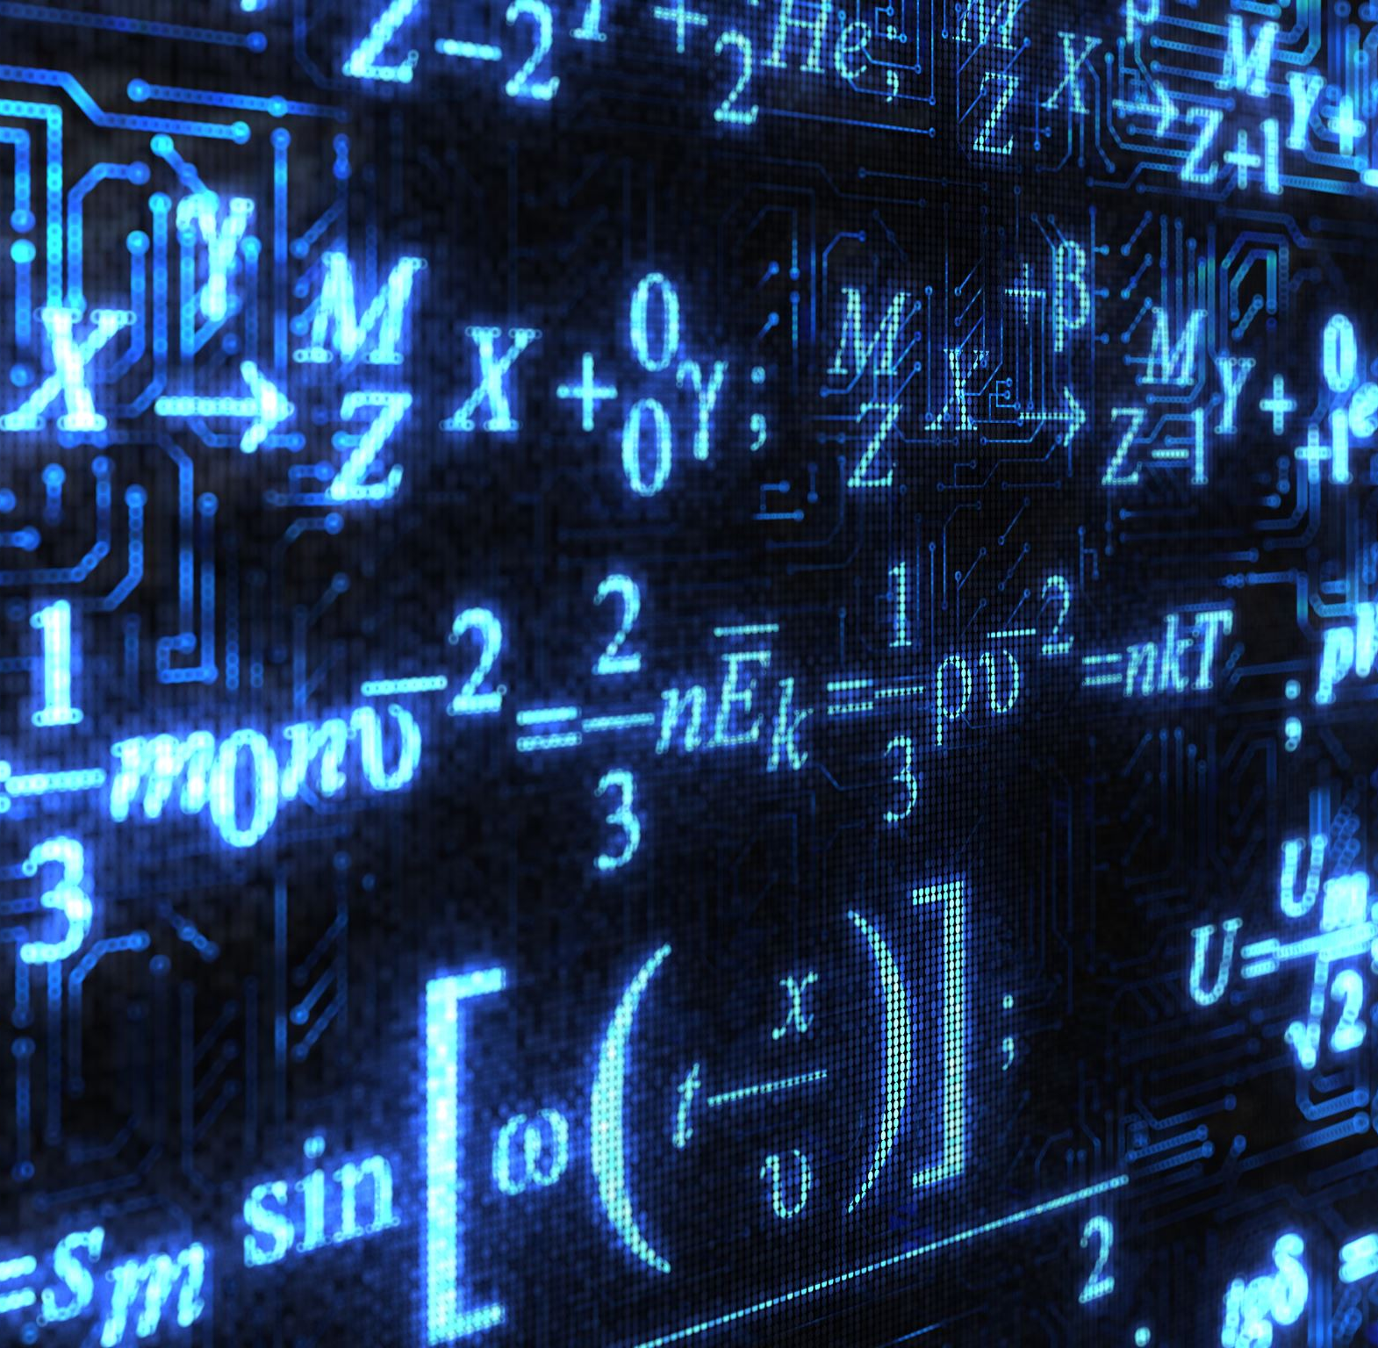
Music Theory and Mathematics
Music has a deep relationship with mathematics.
Discrete whole numbers are used for labeling pitches/keys
Helps with pattern recognition
We perceive pitch as a relative value , we perceive ratio between frequencies.

Slide 6

The dataset
301 midi files scraped from https://bushgrafts.com/midi/.
295 midi files downloaded from https://www.kaggle.com/soumikrakshit/classical-music-midi
Additionally over 400 piano midi files were obtained from a personal collection.
Processed via music21 library.

Slide 7

Methodology
Use LSTM and Wavenet model architectures
Look at model performance through whether they are overfit/underfit and look at val_loss.
Address concerns that may arise
This Photo by Unknown Author is licensed under CC BY-NC-ND

Slide 8
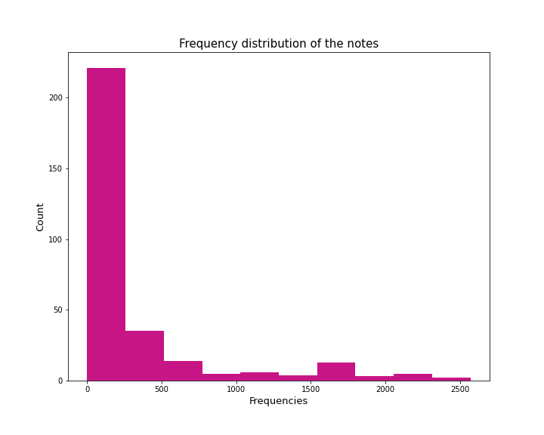
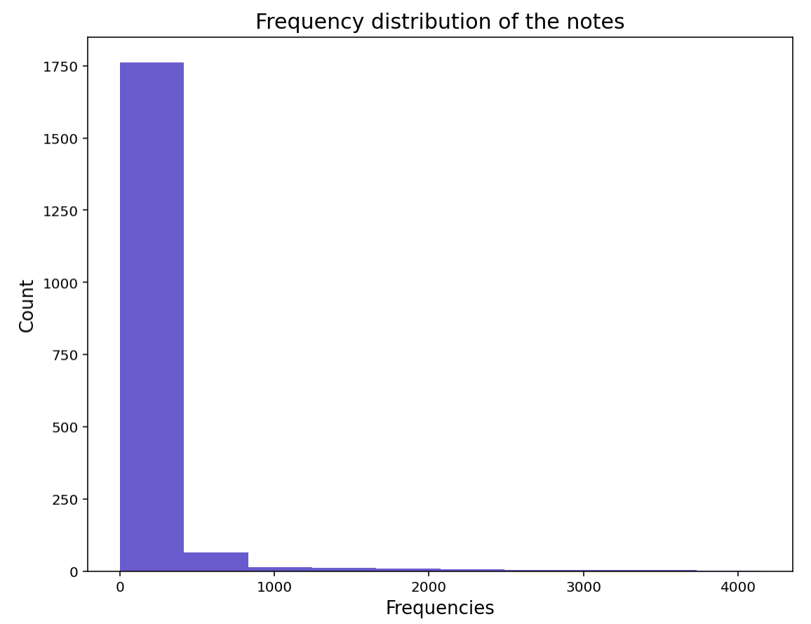

Slide 9
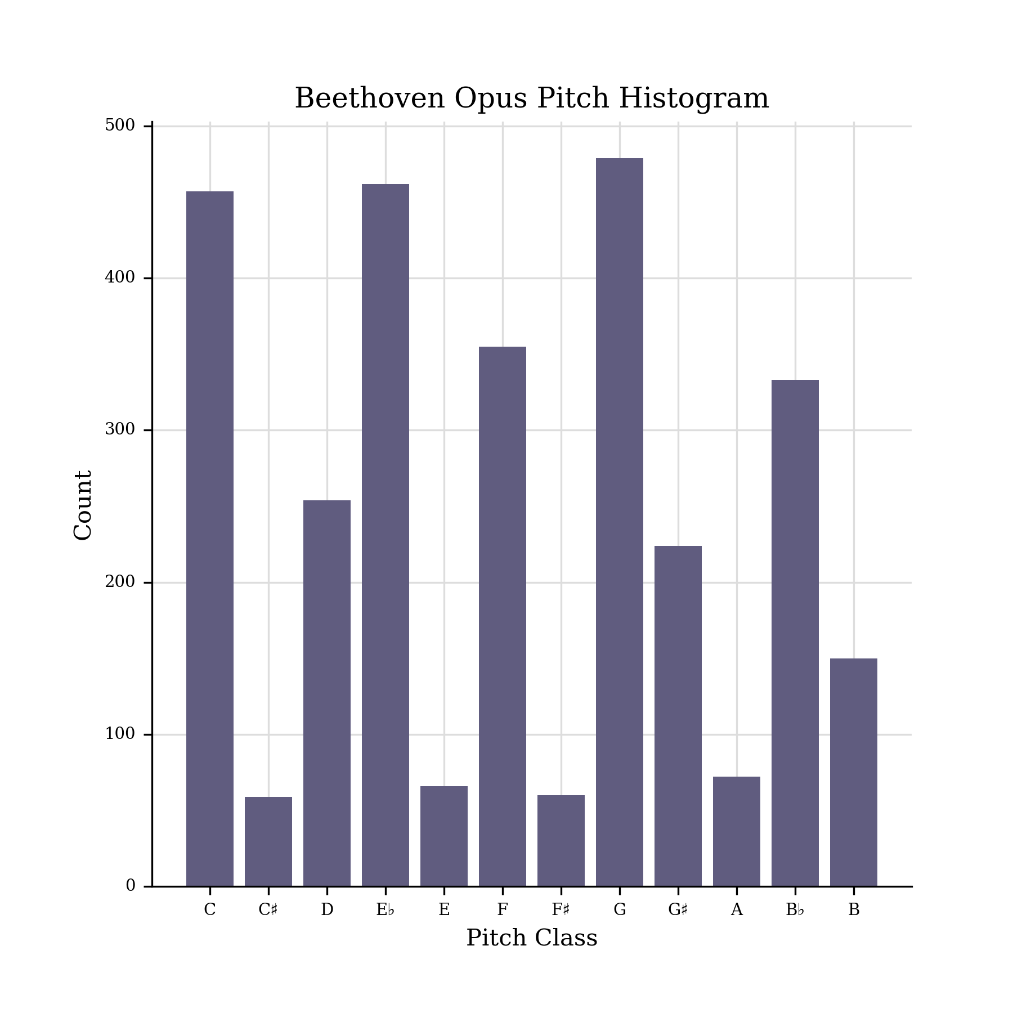
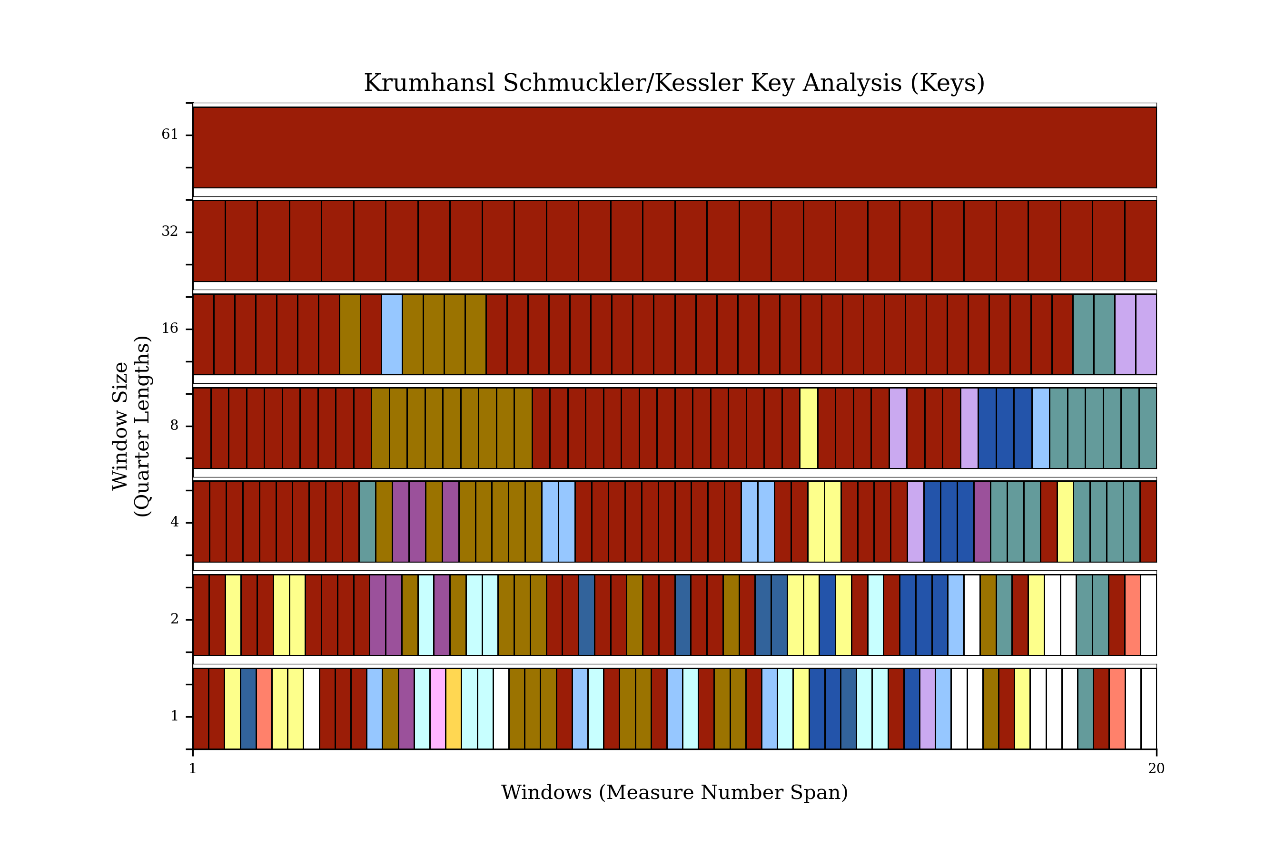
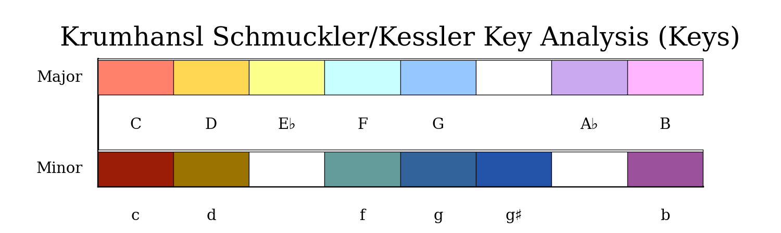

Slide 10
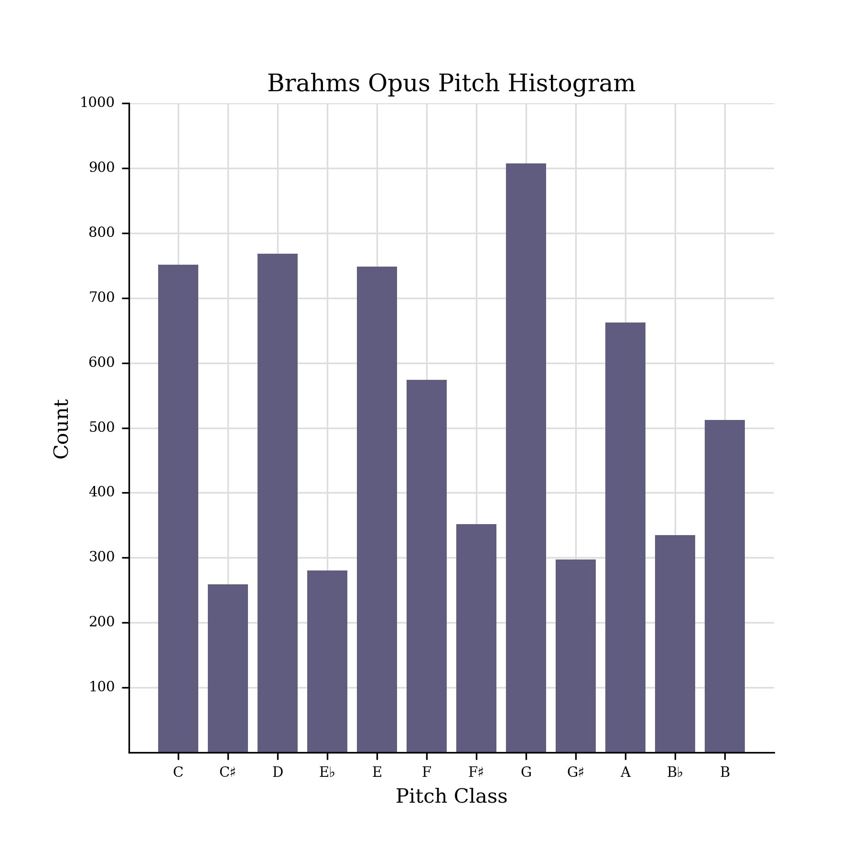
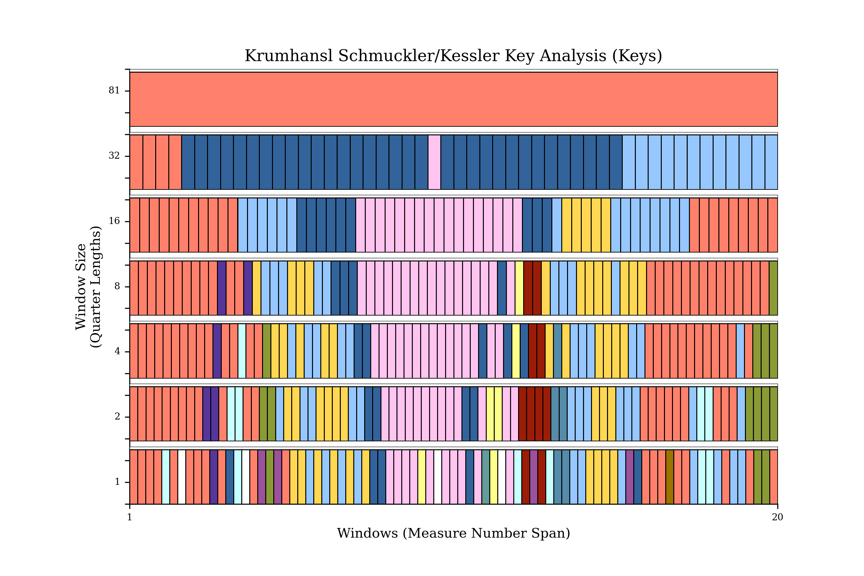
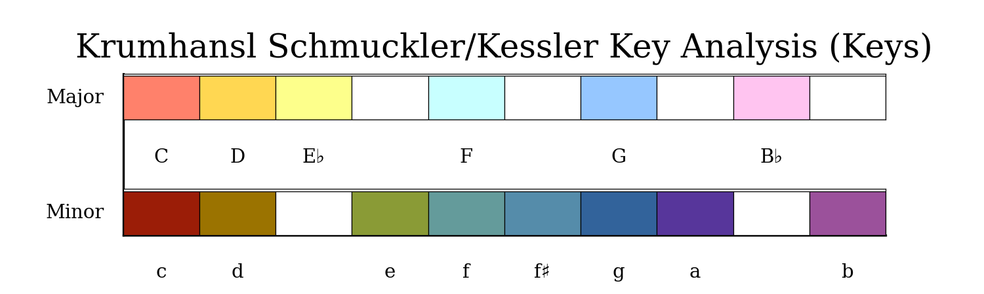

Slide 11
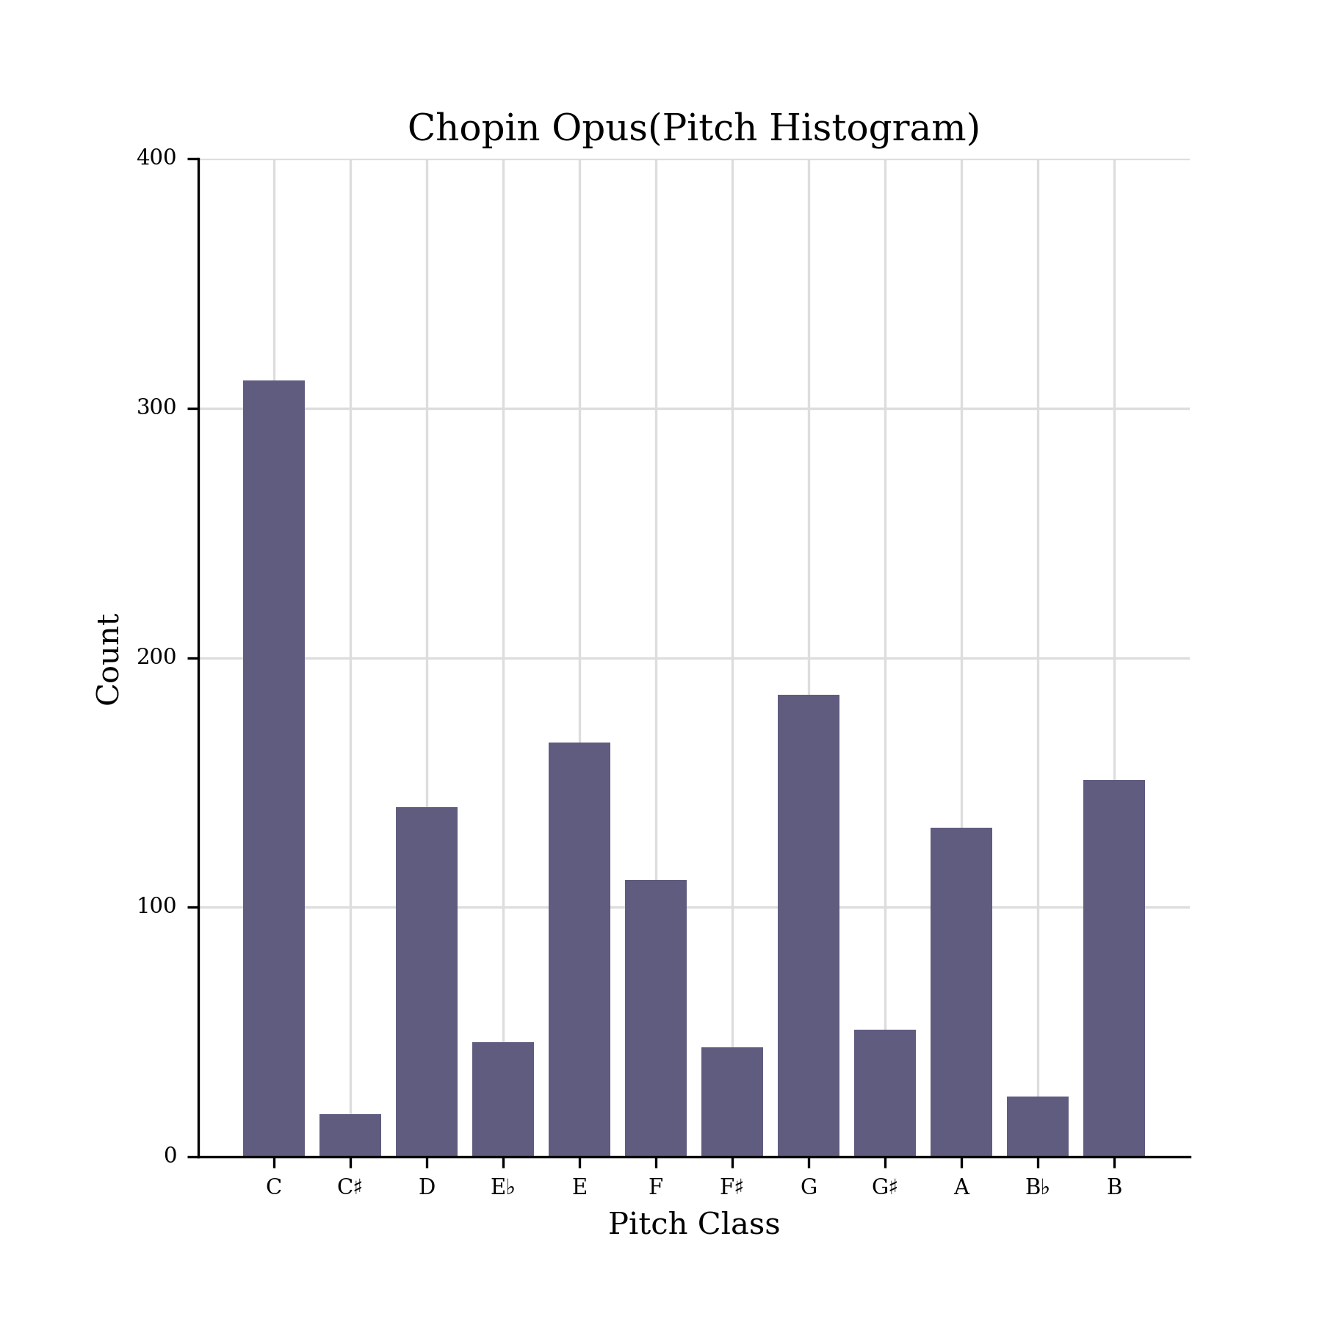
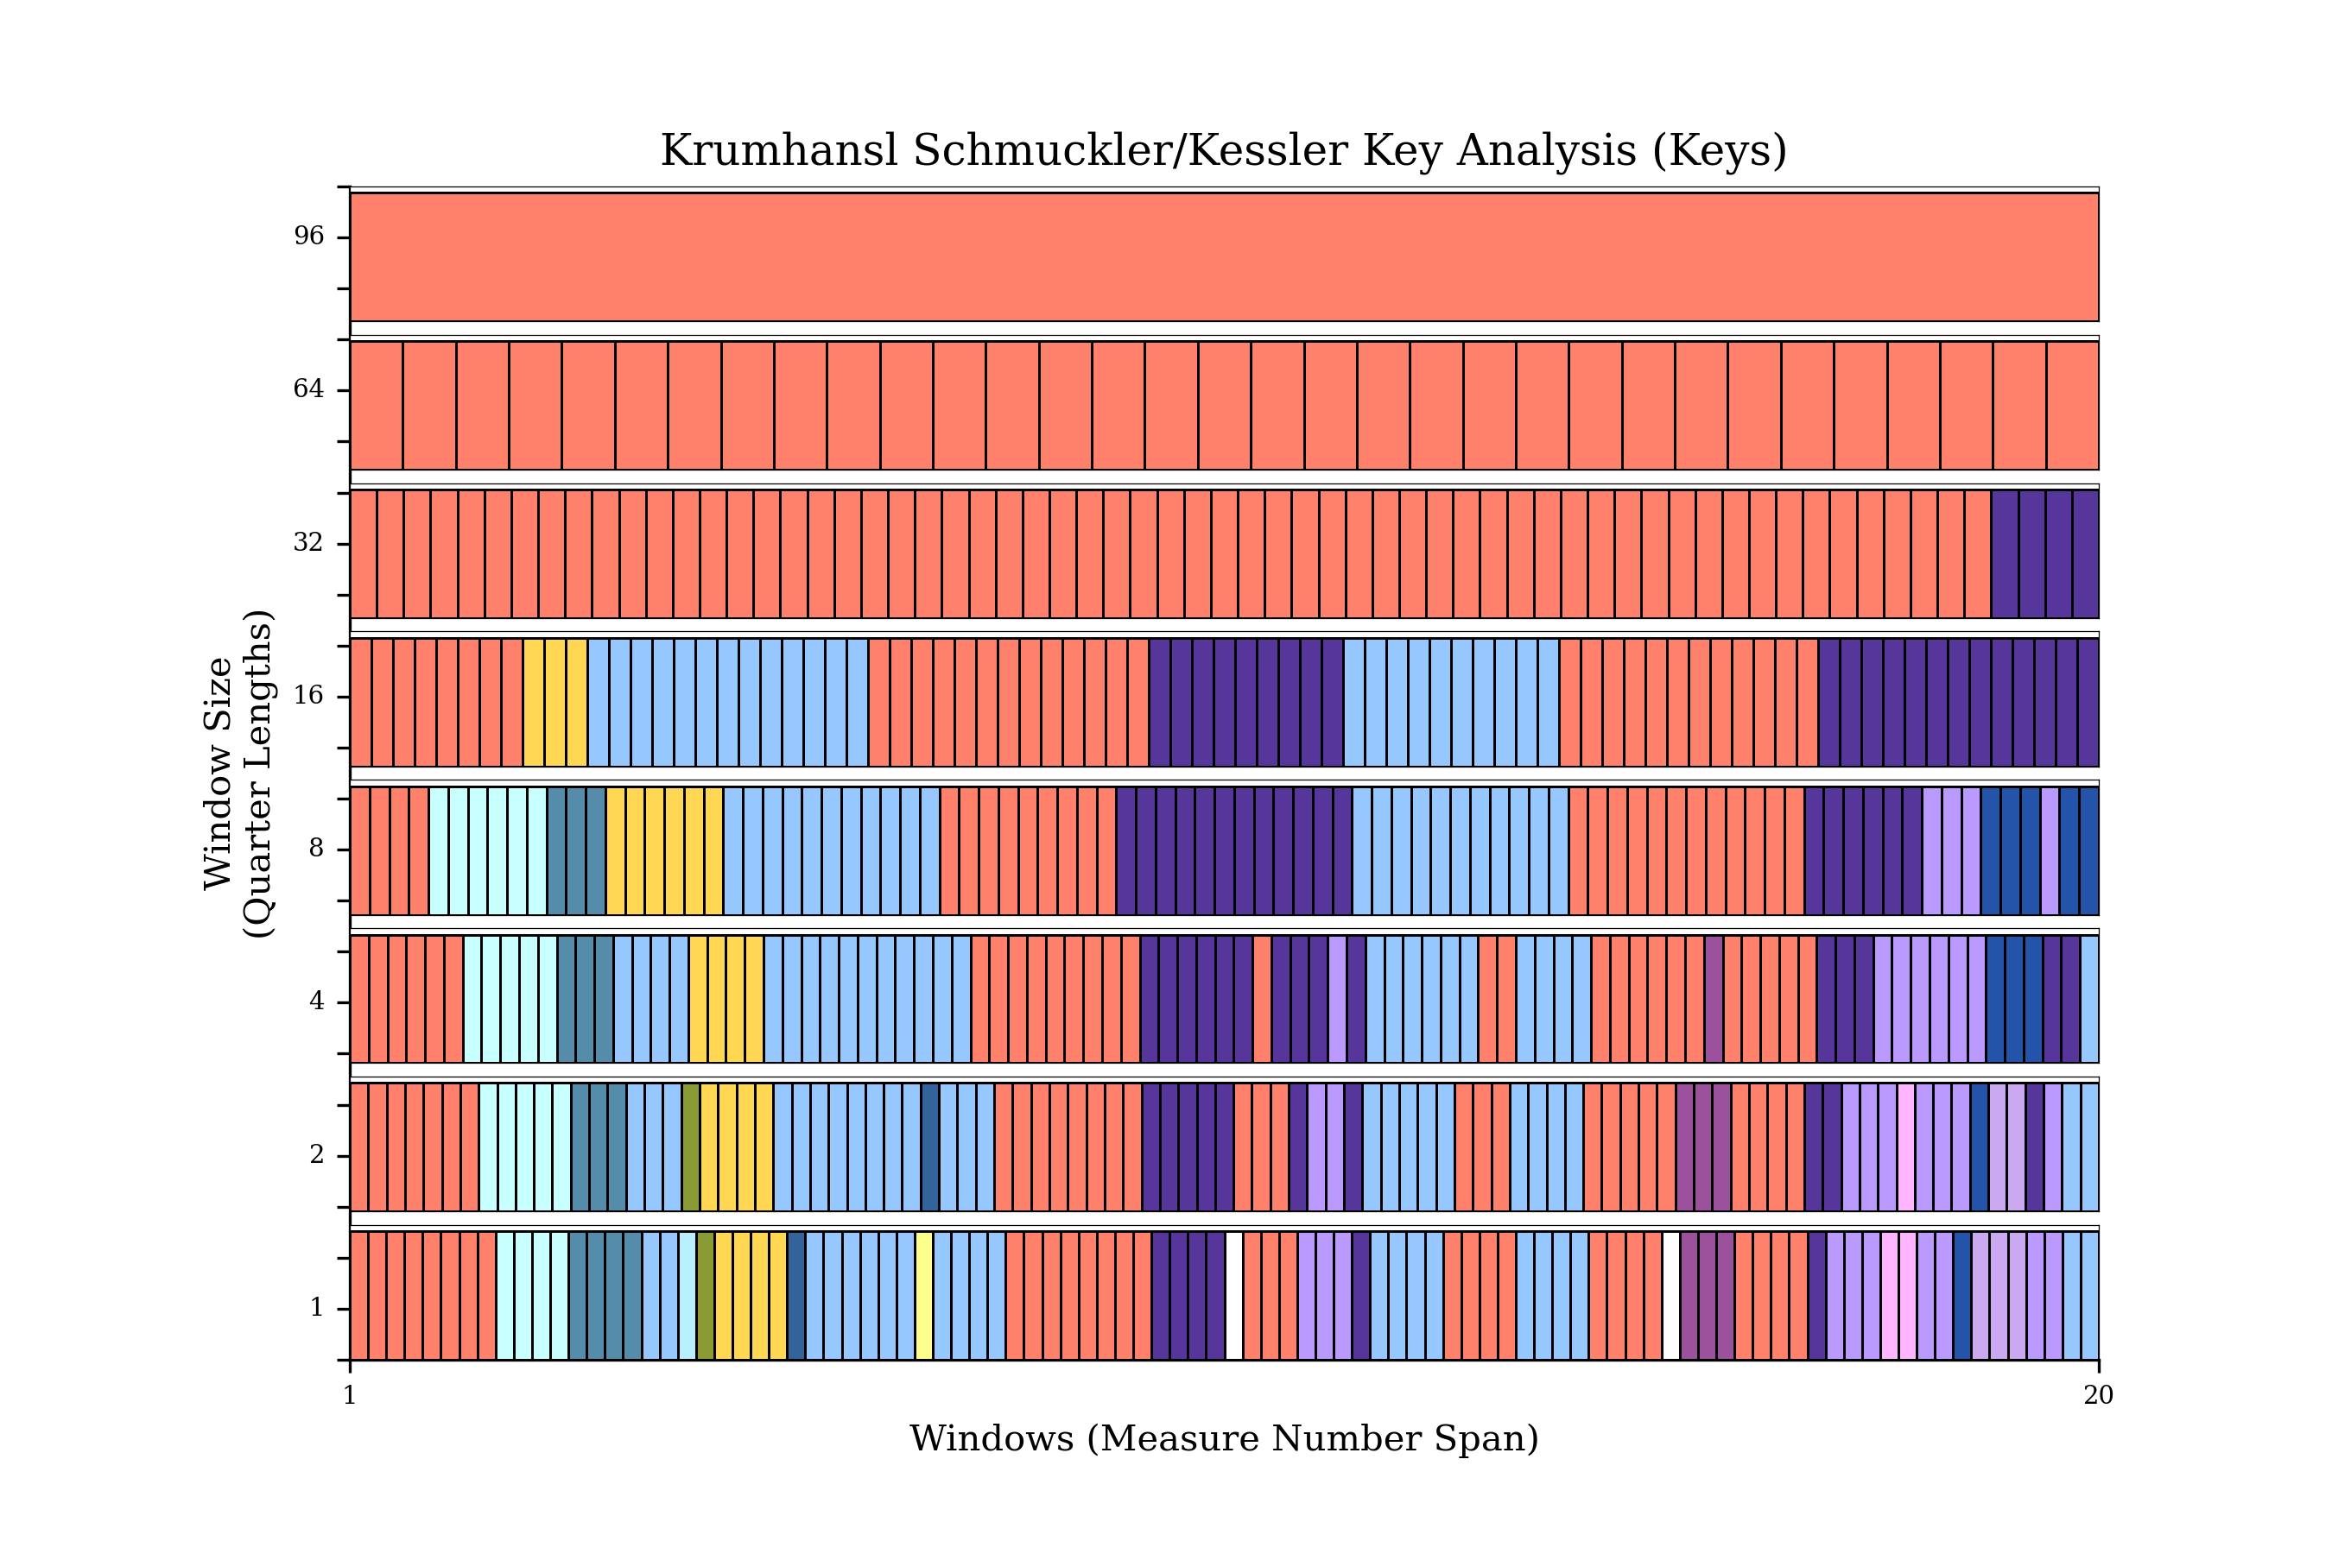
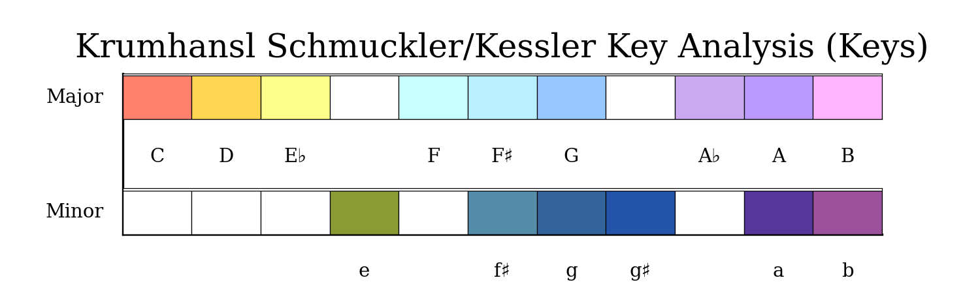

Slide 12
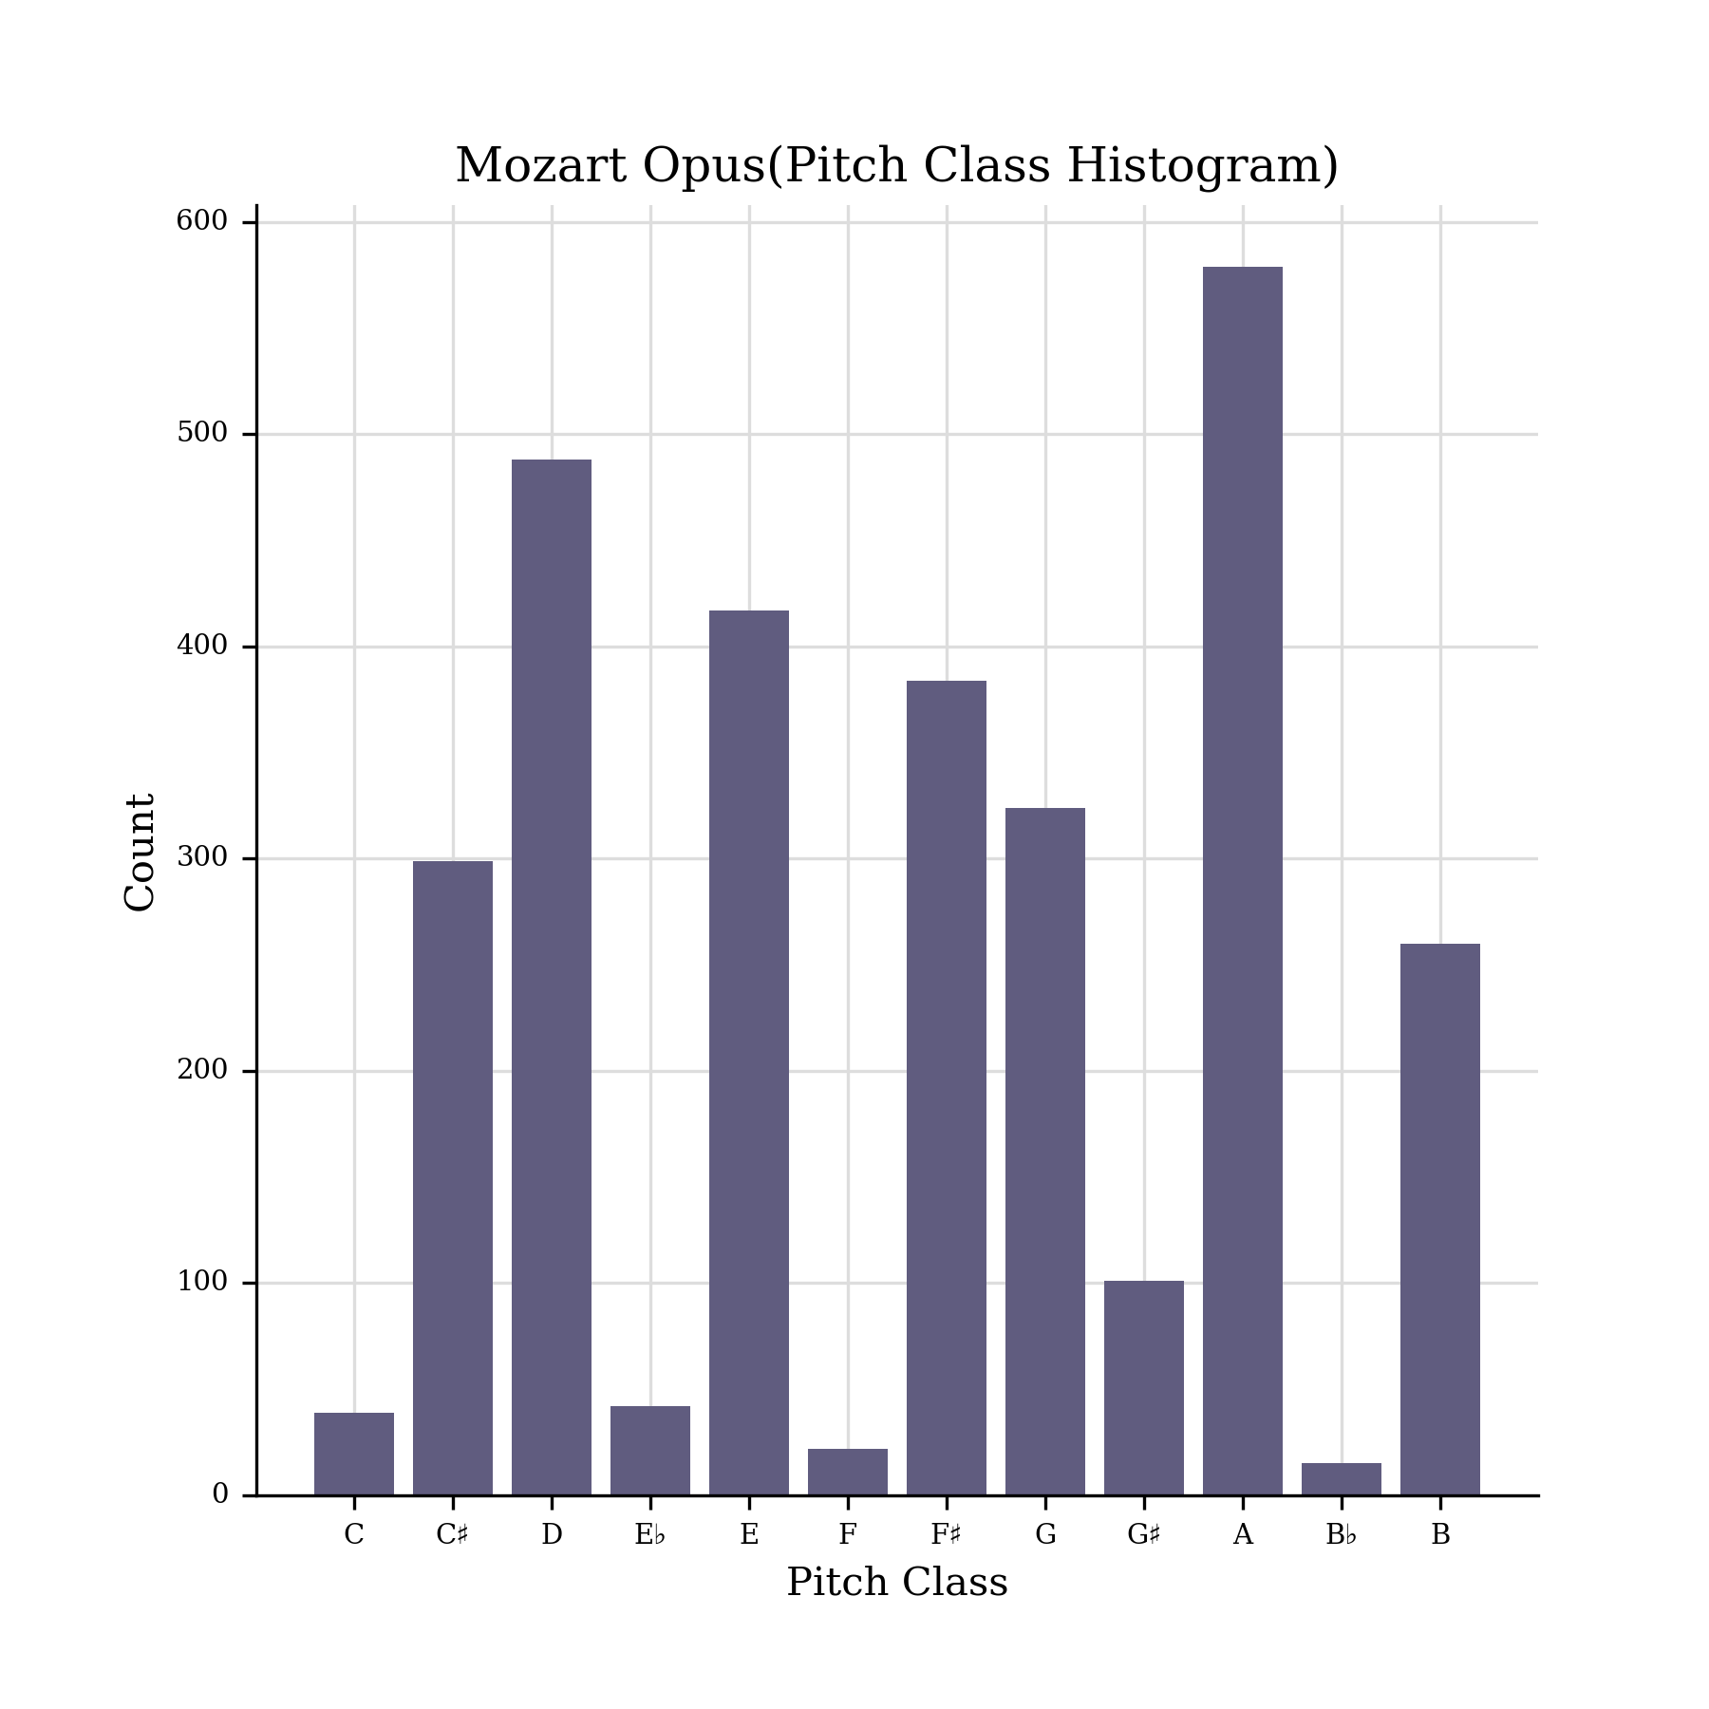
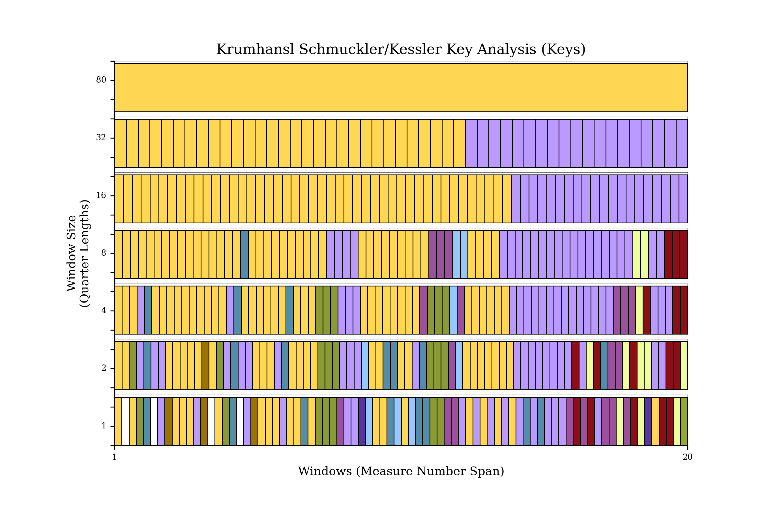
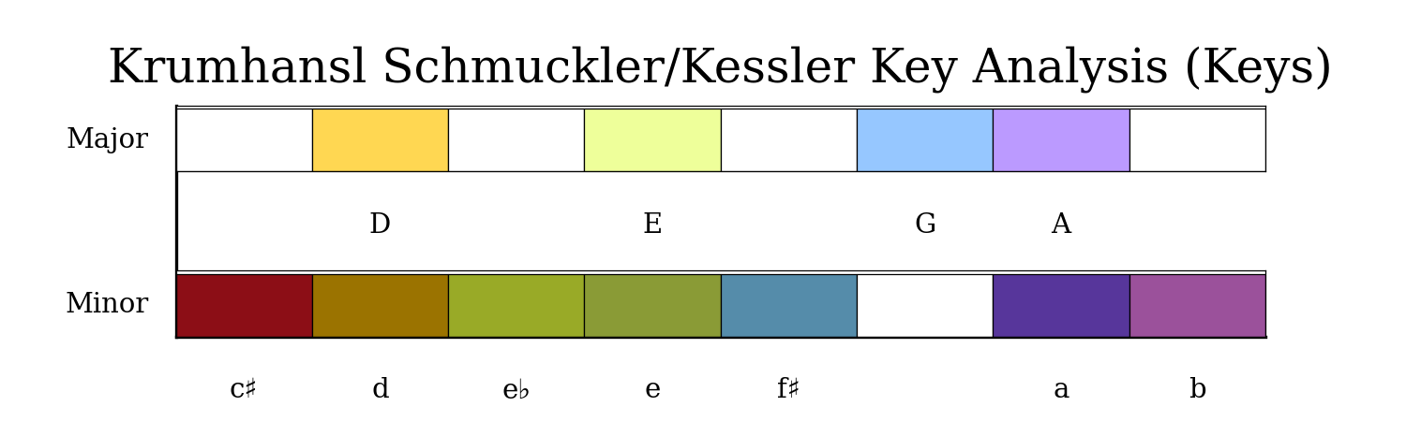

Slide 13

Modeling Approach
Music 21
CNN model(Wave net)
RNN model(LSTM)

Slide 14

Round 1 Wavenet models
This Photo by Unknown Author is licensed under CC BY

Slide 15
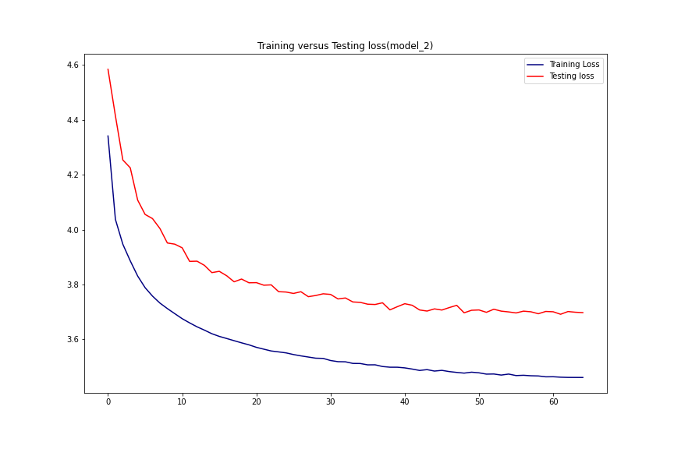
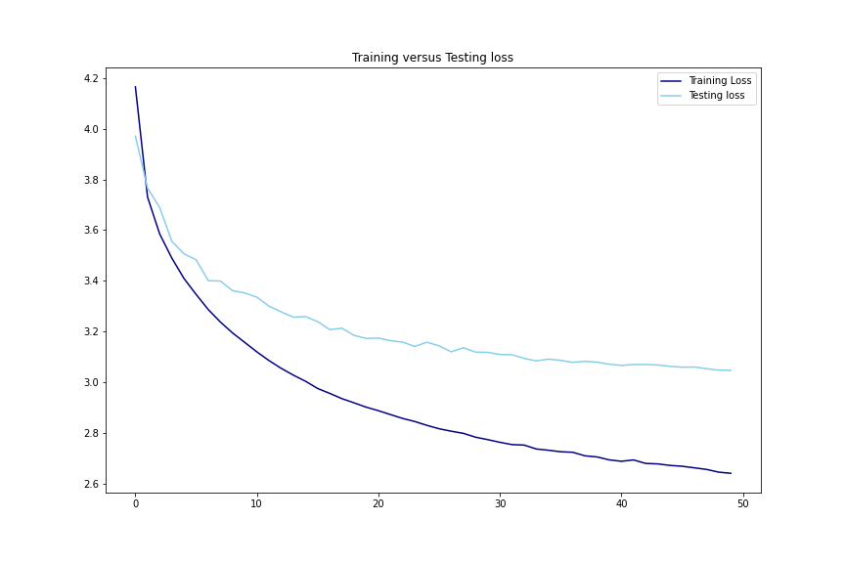

Slide 16
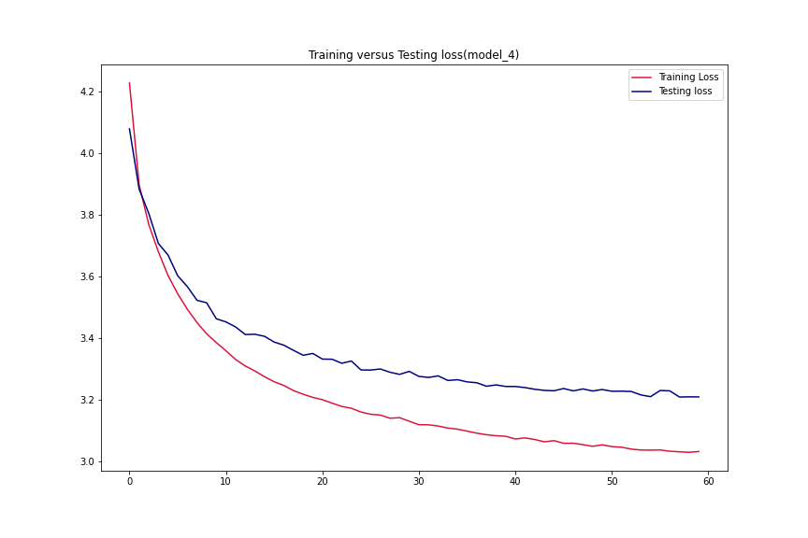
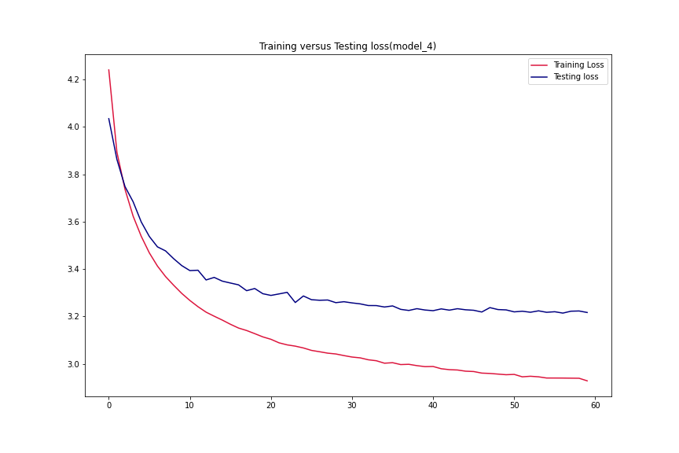

Slide 17

Round 1:LSTM models

Slide 18
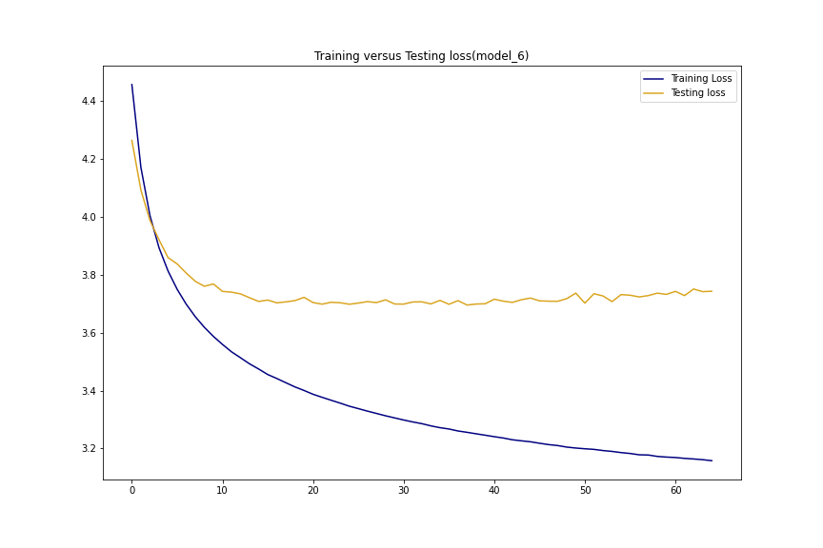
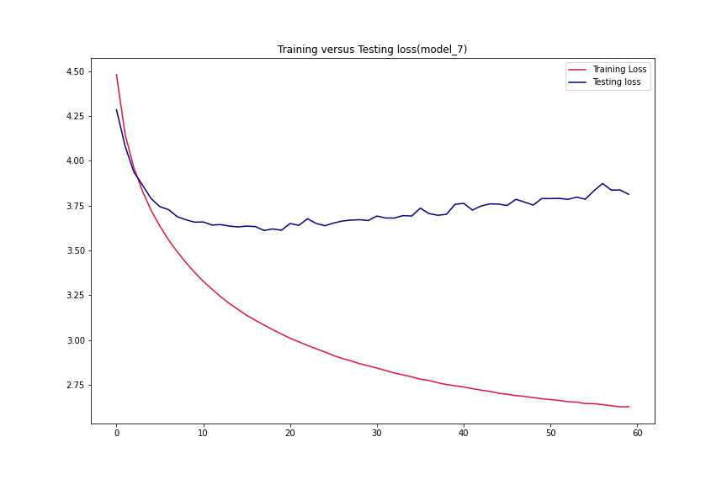

Slide 19
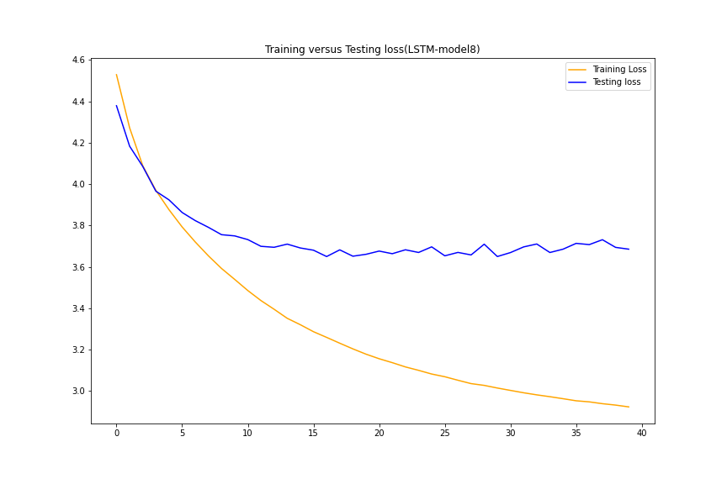
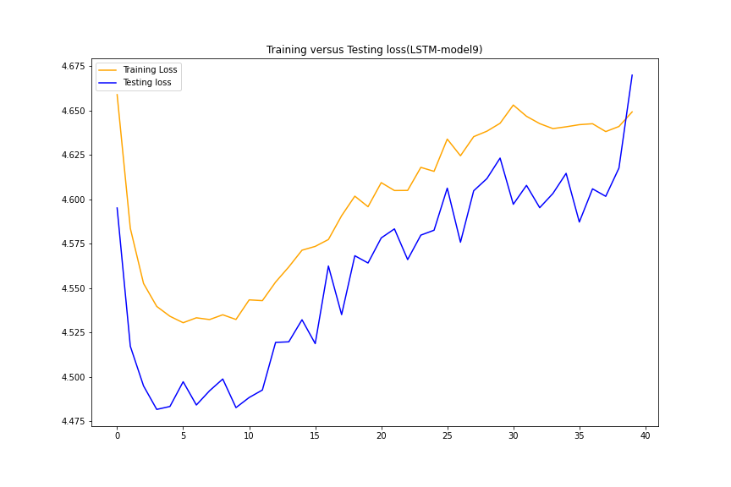

Slide 20
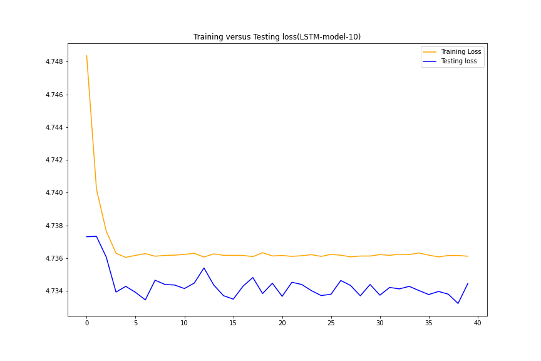
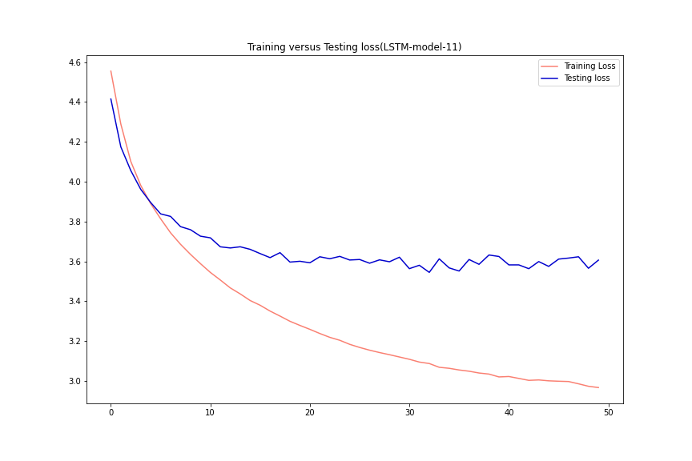

Slide 21
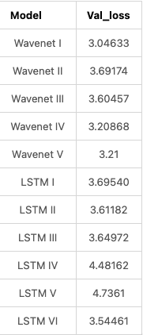

Slide 22

Round 2 Addressing the underfitting

Slide 23
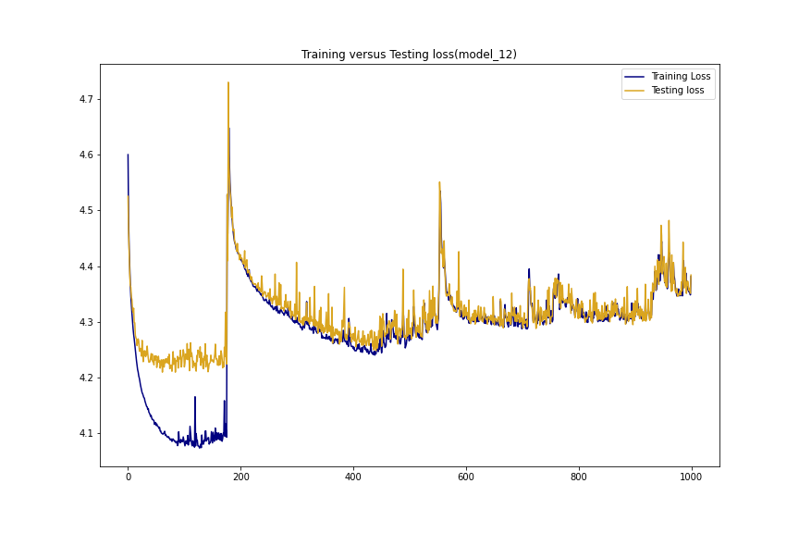

Slide 24
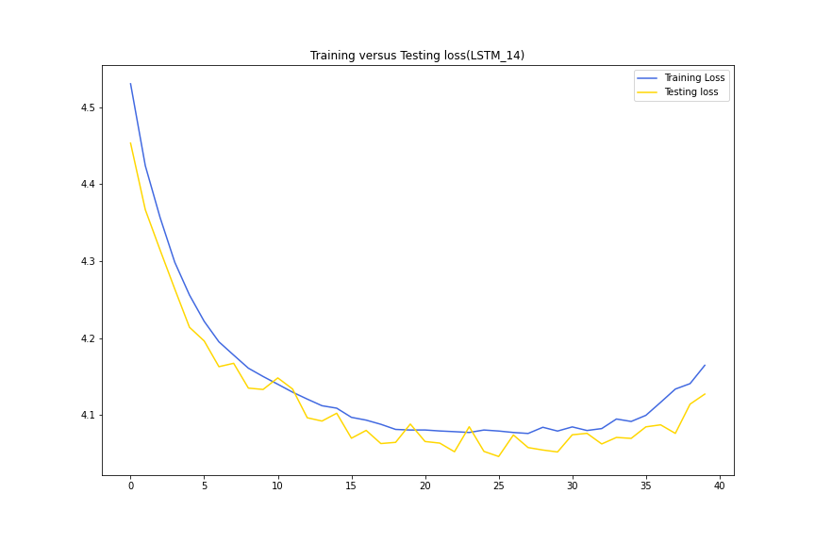

Slide 25
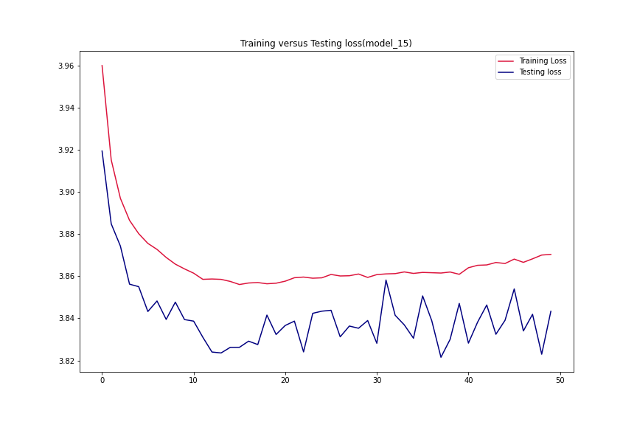
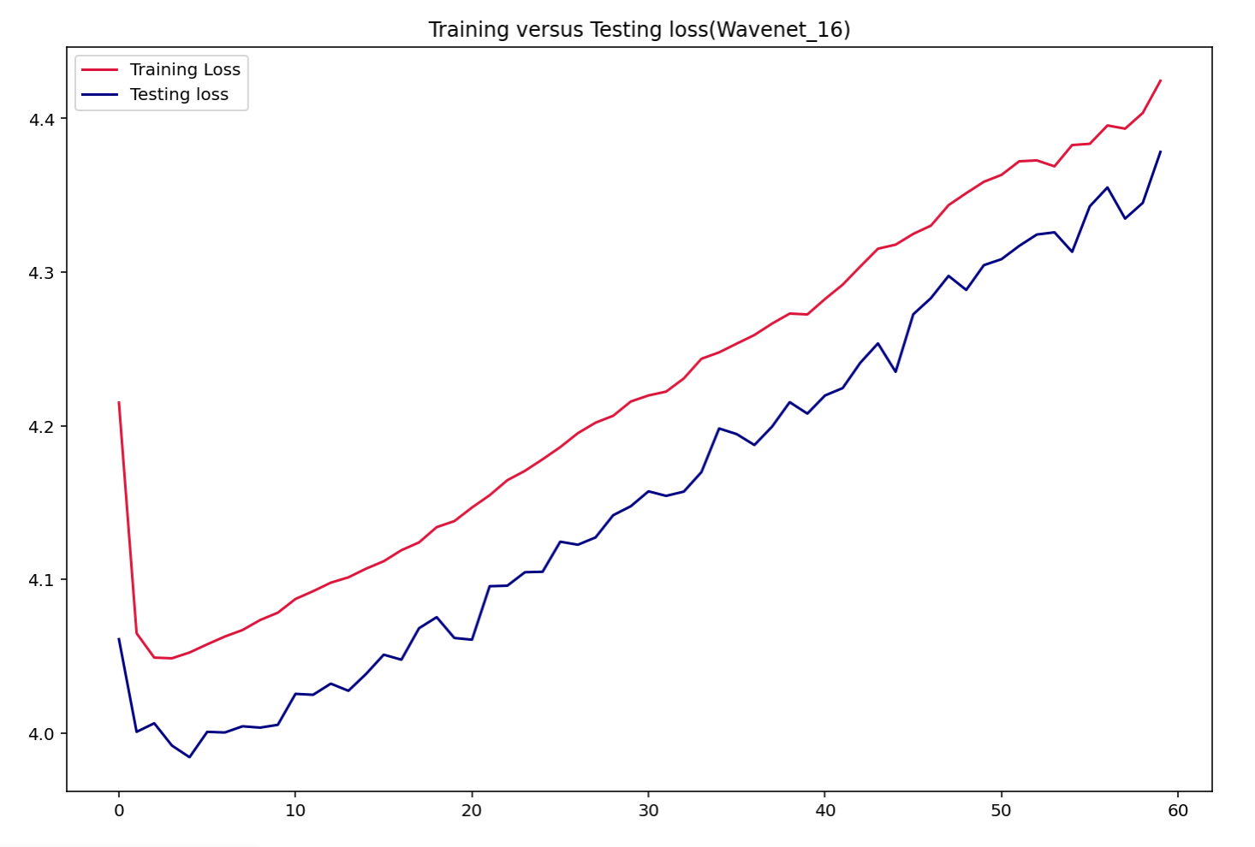

Slide 26
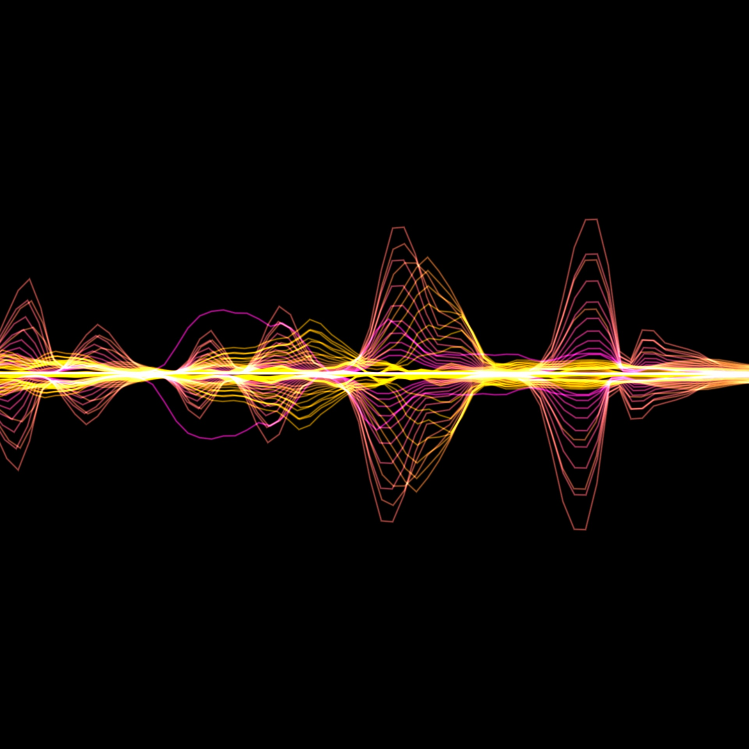
Conclusion
Round 1 best performing models: 4th Wavenet, and the 5th wavenet models. Models were able to generate notes.
2nd round attempts to address the underfit issues of previous models, through more epochs, and larger datasets. These generate music with monotone quality to them.

Slide 27

Next Steps
Need a midi editor to process files that have excess tracks with nothing in them.
LSTM architectures can be enhanced either by feeding it more data or adding encoder/decoder layers to improve model performance.
Combine some of the successes.

Slide 28
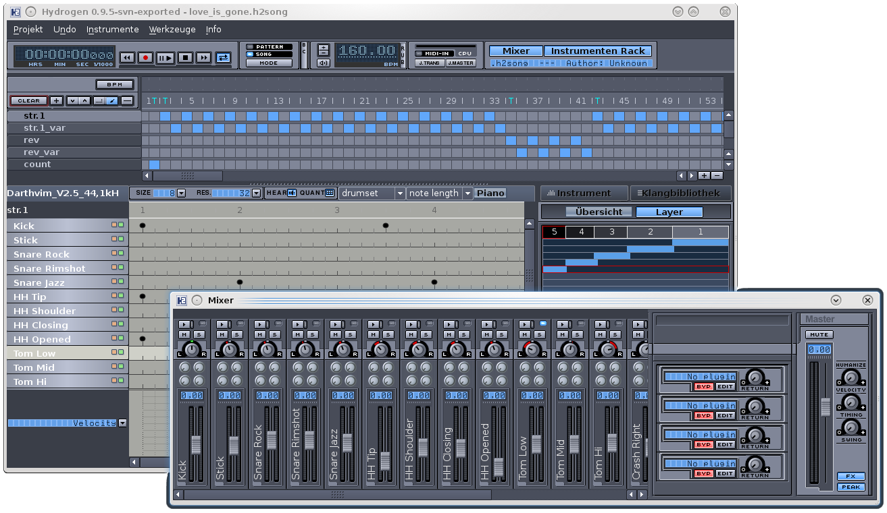
The generated music

